Slide 1
Design Principles & Patterns
CP1403
Design Thinking

Slide 2
Notes
MIRO
For non-Pen&Paper sketches, Miro has good app template
https://miro.com/templates/app-wireframe-tool/

Slide 3
Learning Objectives
Explain what is interaction design
Understanding the role of psychology (Flow) in interaction design
Designing for good mental and physical ergonomics
Using design pattern

Slide 4
Interaction Design
Interaction design (IxD) is all abut the ease and intuitiveness of interacting with a product
When done correctly, the product “just work” ( intuitively)
When poorly design, users has to “think”, “figure out” how to use the product

Slide 5
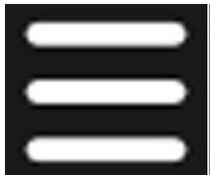
Activity 1 Group Discussion (10 minutes) What action is afforded by this icon ? Should We avoid this ? And How ?
Notes:
Reference :
http://www.bbc.com/news/magazine-31602745
https://lmjabreu.com/post/why-and-how-to-avoid-hamburger-menus/

Slide 6
Views from the web
Burger articles:
http://www.bbc.com/news/magazine-31602745
https://lmjabreu.com/post/why-and-how-to-avoid-hamburger-menus/
Laws of UX - Jakob’s Law:
“Users spend most of their time on other sites. This means that users prefer your site to work the same way as all the other sites they already know.” Jakob’s Law | Laws of UX

Slide 7
Getting into the Flow
Flow (Named by Mihály Csíkszentmihályi)
also known as zone
is the mental state of operation in which a person performing an activity is fully immersed in a feeling of energized focus, full involvement, and enjoyment in the process of the activity.
Flow is characterized by complete absorption in what one does.
Software design should fully engage the users without distractions or disruptions

Slide 8
Ways to Facilitate Flow
Create the Right Affordances
the quality or property of an object that defines its possible uses or makes clear how it can or should be used
Match the User’s Mental Model
Avoid Modal States and Disruptions
Be Available
Give Good Feedback
Reduce Clutter

Slide 9
Create the Right Affordances
Affordance is the quality of an object allowing an action-relationship with an actor
User of your application/device should not have to guess what is interactive and what is not
Ensure buttons look touchable/clickable, that scrollable content looks scrollable
Custom gestures like pinch and rotate are associated with content that make sense for those interactions.

Slide 10
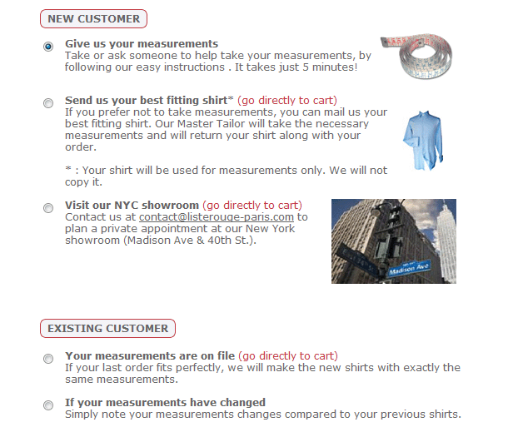
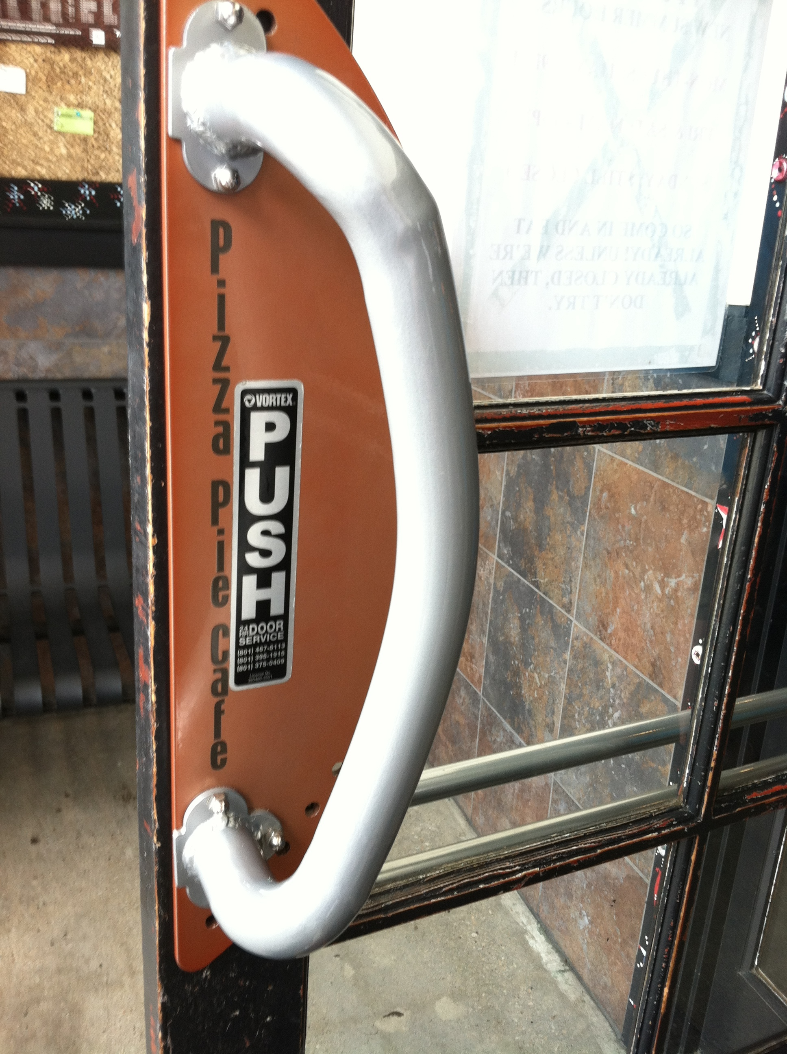
Bad Examples of Affordance
Notes:
New customer and Existing Customer look like buttons, but they are not

Slide 11
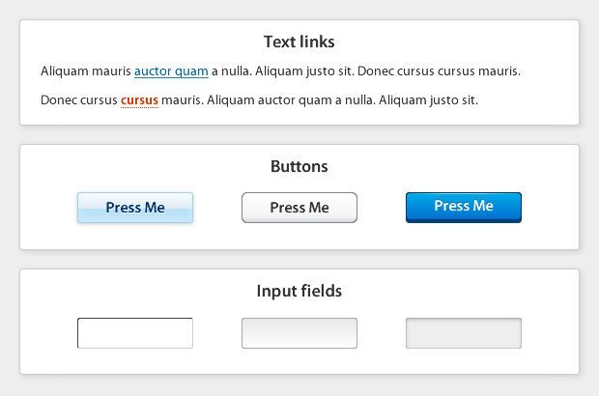
Good Examples of Affordance
Notes:
New customer and Existing Customer look like buttons, but they are not

Slide 12
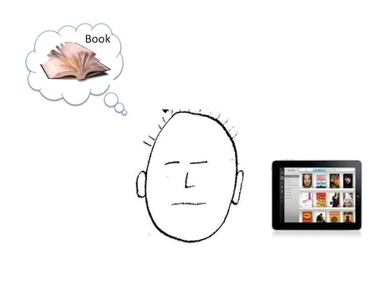
Match the User’s Mental Model

Slide 13
Activity 2 Group Discussion (5 minutes) Do you agree or disagree the following sentence ? Why? The closer an application mimics the way we use real-world products, the better the user experience
Notes:
Waching machine remore control app…

Slide 14
Avoid Modal States and Disruptions & Be available
The last thing you want is to stop users in their tracks while they’re in the middle of doing something.
Use appropriate type of notifications / alerts
However, at the same time you need to make sure information needed is easily accessible (available immediately on screen) to the user
E.g. pass order history, instead of asking users to input order ID/# number

Slide 15
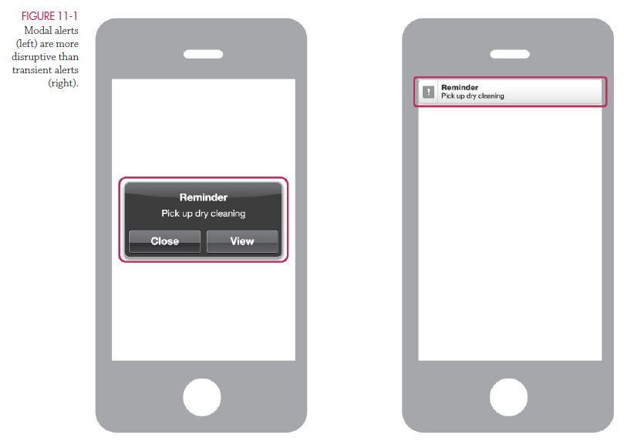
Avoid Modal States and Disruptions & Be available

Slide 16
Give Good Feedback
Feedback and responsiveness go hand in hand and are extremely important for facilitating flow
Users shouldn’t have to guess whether they touched or clicked something
Avoid screen locking: user clicks something, and the screen becomes unresponsive and locks until the system is done “thinking.”

Slide 17
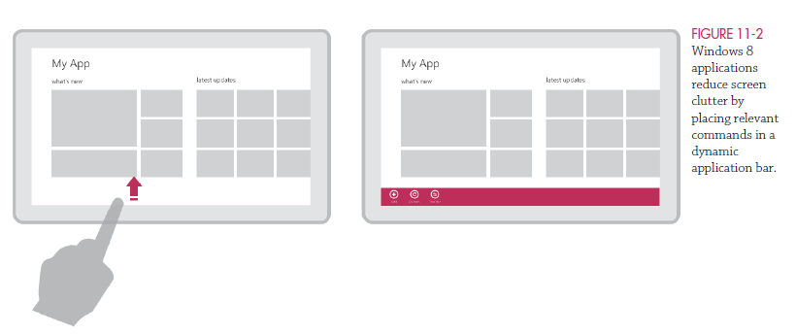
Reduce Clutter
Show features only when they’re relevant and needed

Slide 18
Ergonomics
Ergonomics is the discipline of design committed to making products fit nicely with the human body, mentally and physically
For software/application design, these areas are the most relevent
Muscle Fatigue
Field of View and Peripheral Vision
Environment and Lighting Conditions
Optimal Touch Targets
Occlusion

Slide 19
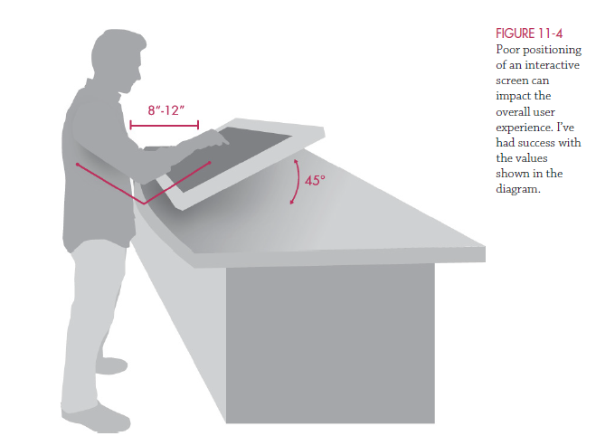
Ergonomics - Muscle Fatigue
It is importance to consider when designing for interfaces that are to be used in public or for prolonged use, especially for touch-based and gestural systems.

Slide 20
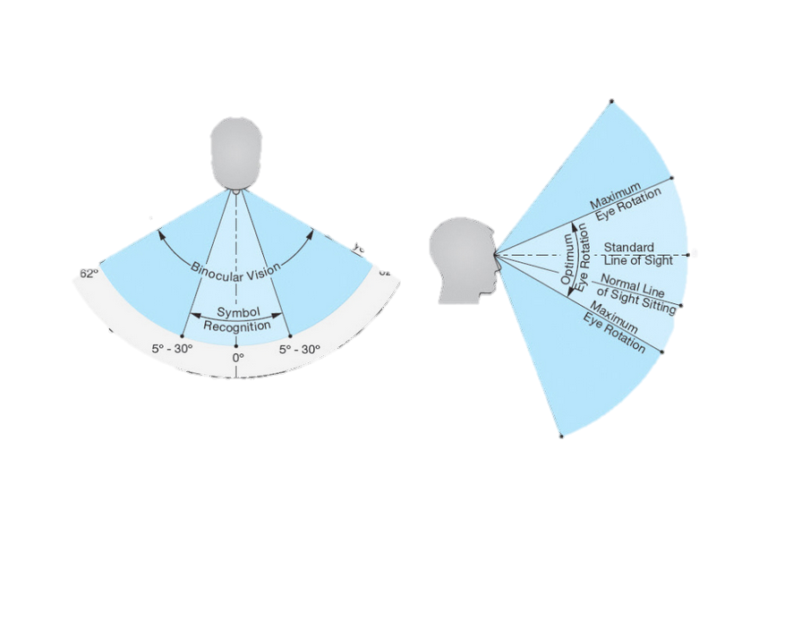
Ergonomics – Field of View and Peripheral Vision
It is importance to consider when designing for interfaces that are to be used in public or for prolonged use, especially for touch-based and gestural systems.

Slide 21
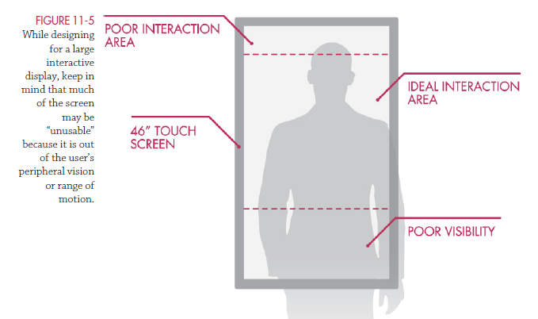
Ergonomics – Field of View and Peripheral Vision

Slide 22
Ergonomics – Environment and Lighting Conditions
Here are some high-contrast techniques I’ve used to deal with intense lighting conditions:
Use white text on a black background.
Use black text on a white background.
Increase the font sizes.
Use thicker font weights.
Use sentence case rather than all caps for better letter recognition.

Slide 23
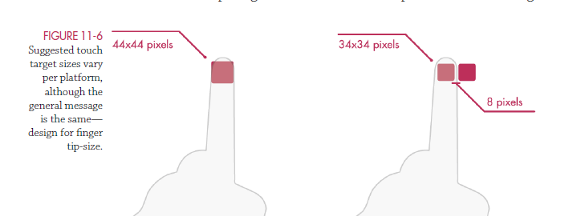
Ergonomics – Optimal Touch Targets
Fingers are not as precise as mouse pointers, and smaller buttons and touch targets are frustrating to use. So in general, targets need to be big.
But exactly how big?
Apple
Microsoft

Slide 24
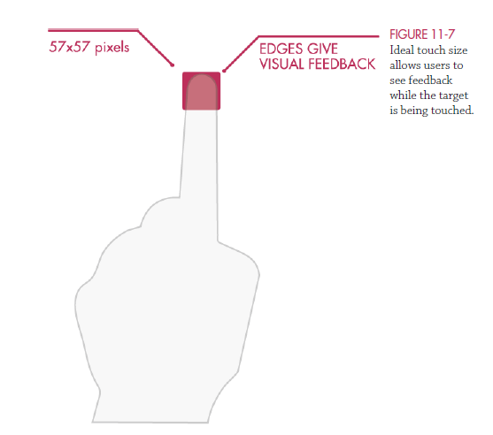
Ergonomics – Optimal Touch Targets

Slide 25
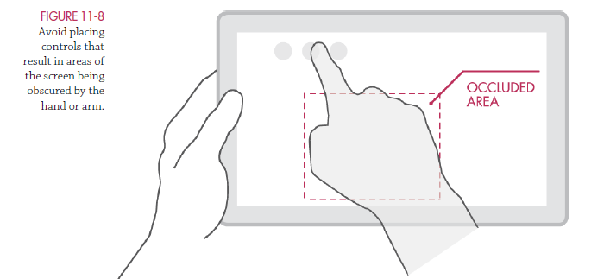
Ergonomics – Occlusion

Slide 26
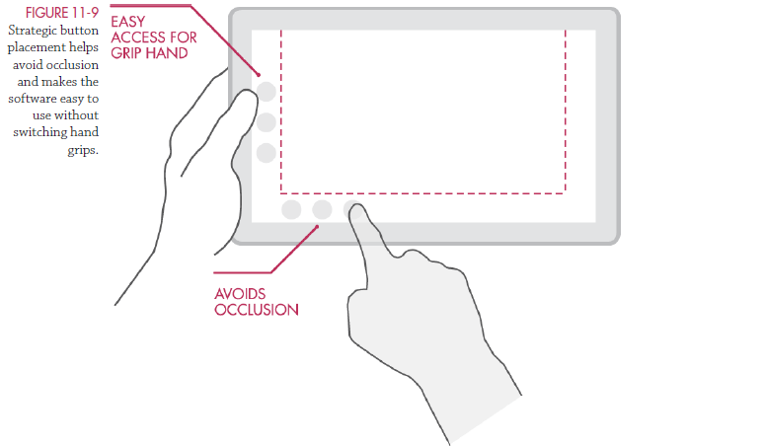
Ergonomics – Occlusion

Slide 27
Design Pattern
Design pattern is a description or template for how to solve a problem that can be used in many different situations.
Reusable, convention, best practices
UI design pattern references library
http://ui-patterns.com/
http://pttrns.com/
https://developer.yahoo.com/ypatterns/

Slide 28
Design Patterns
Let’s explores some common design patterns and the rationales behind
Auto focus
Drag and drop
Auto save
Blank slate
Progressive indicators
Use good target size
A button is a button
Avoid modal states unless it is critical
Direct manipulation
Group like items
Continusous scrolling
Size to importance visualization
Glance-view dashboard
Error proof controls
Get me out of here
Right/left input alignment

Slide 29
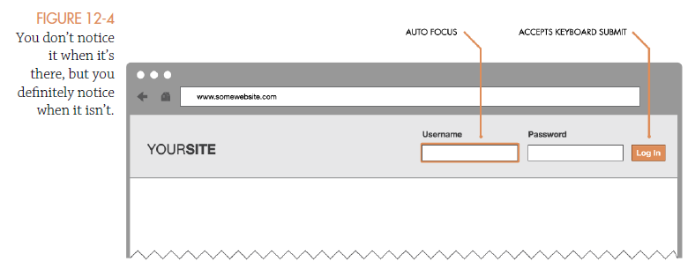
Auto Focus
Work great for search and login, reduce friction between users and their goals

Slide 30
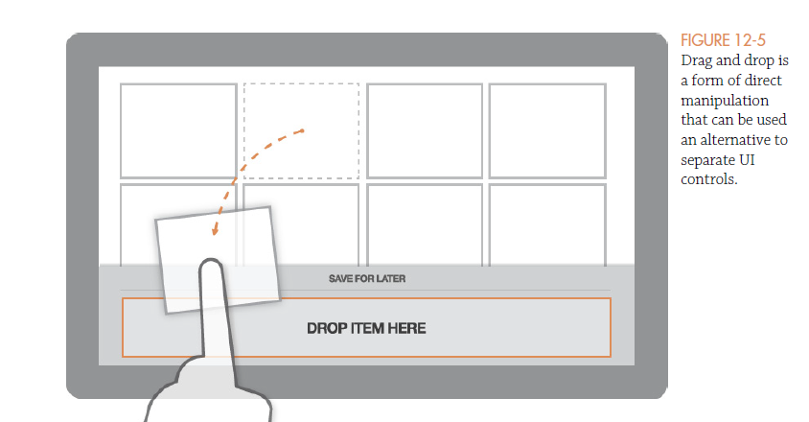
Drag and Drop
Leverage intuitions of users of direct manipulations
Useful for file upload, drag and drop is very intuitive for reordering lists, grouping items (dropping one item on another), resizing elements, and sharing information from app to app

Slide 31
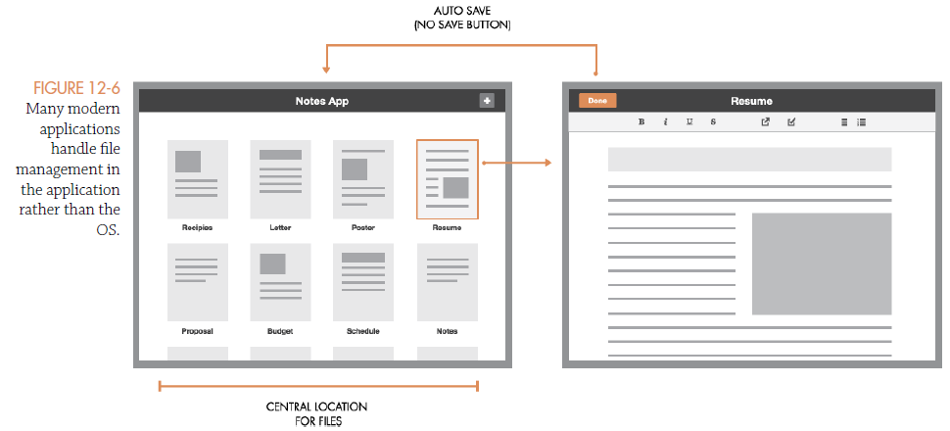
Auto Save
Auto saving will save the user’s current working document to the storage mechanism without prompting the user to do so.

Slide 32
Blank Slate
The blank slate is the default screen in your application before it has been saturated with data.
Use this screen to give your users good visual and interaction cues.
This will help them orient themselves during the their first-time use.

Slide 33
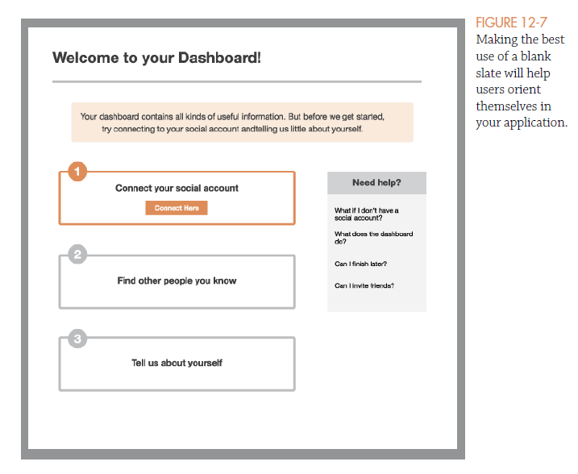
Blank Slate

Slide 34
Progress Indicators
Progress indicator can hugely impact the perceived responsiveness of your application
There are different types of progress indicators
Overall indicators
Determinate indicators
Indeterminate indicators

Slide 35
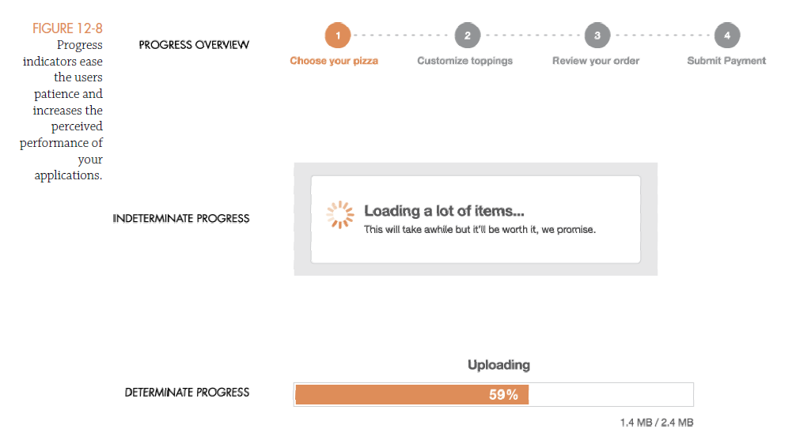
Progress Indicators

Slide 36
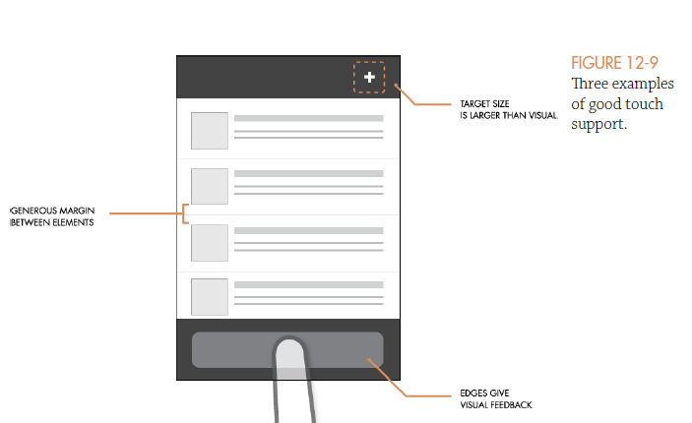
Use good target size
Using good target sizes can reduce spurious and unintended touch/click errors and improve the overall usability of the application.

Slide 37
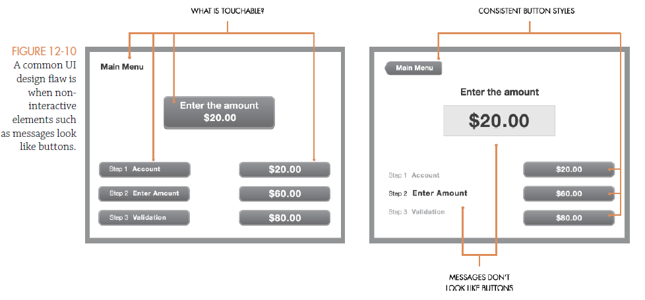
A Button is a Button

Slide 38
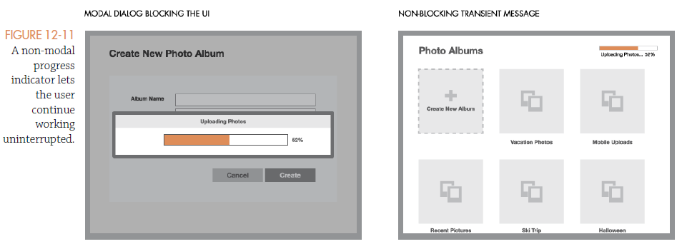
Avoid Modal States unless It’s Critical to Use Them

Slide 39
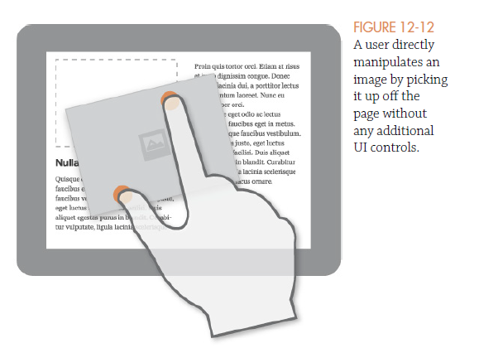
Direct Manipulation
Direct manipulation can be a very simple and easy-to-remember strategy for designing a UI
Not everything can support direct manipulation, and in many cases, it should be avoided.

Slide 40
Group Like Items
Keeping related items in close proximity is a Gestalt design principle.
When we see items placed close together we perceive them as being related or forming a group.

Slide 41
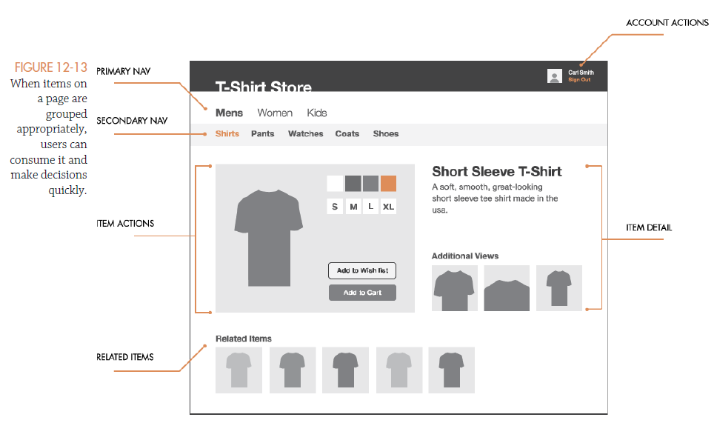

Slide 42
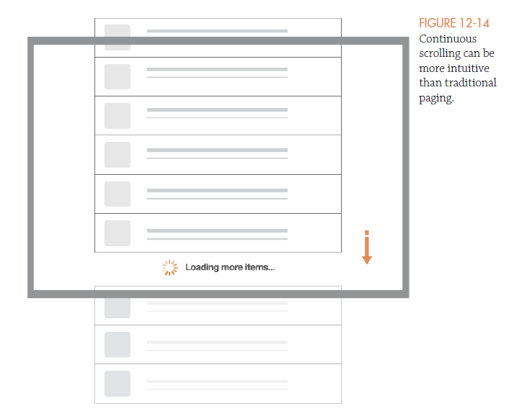
Continuous Scrolling

Slide 43
Continuous Scrolling
Continuous scrolling is preferred over traditional pagination because it creates a “lighter” experience.
The act of clicking “next page” in a paginated dataset forces users out of the act of consuming the data and momentarily breaks their attention.

Slide 44
Size to importance visualization
This design pattern enables you to visualize relational qualities of a dataset.
The proportional sizing of the elements gives the users the ability to spot outlier data items at a glance.
By proportionally sizing the elements on the page, you can create an interesting visualization that is easy for users to consume at a glance.

Slide 45
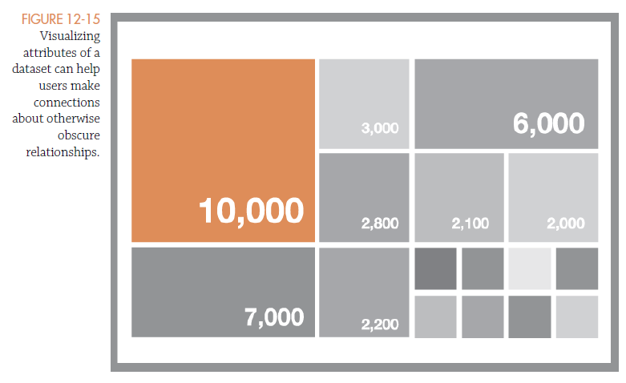
Size to importance visualization

Slide 46
Glance-View Dashboard
Dashboard contains all of the relevant information that a user may want to act on without unnecessary details
It’s important to curate the content, limit the page to just the information the user can’t live without, and keep it up to date
Use color coating and clear indicators for elements that need the user’s attention

Slide 47
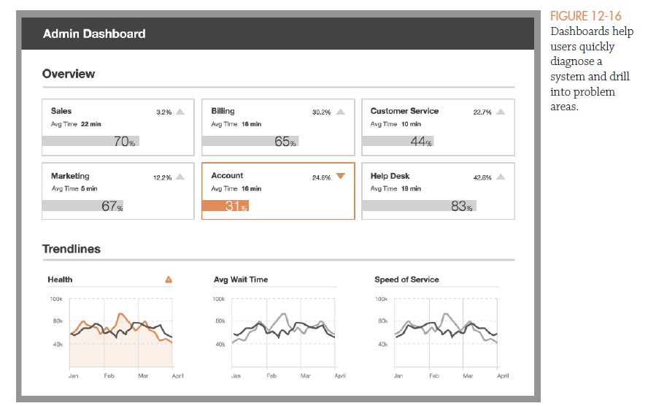
Size to importance visualization

Slide 48
Error-Proof Controls
Error-proof controls are input controls that prevent the user from entering invalid data before it causes an error message or becomes a problem.
It may even auto-correcting input by appending or removing unnecessary characters

Slide 49
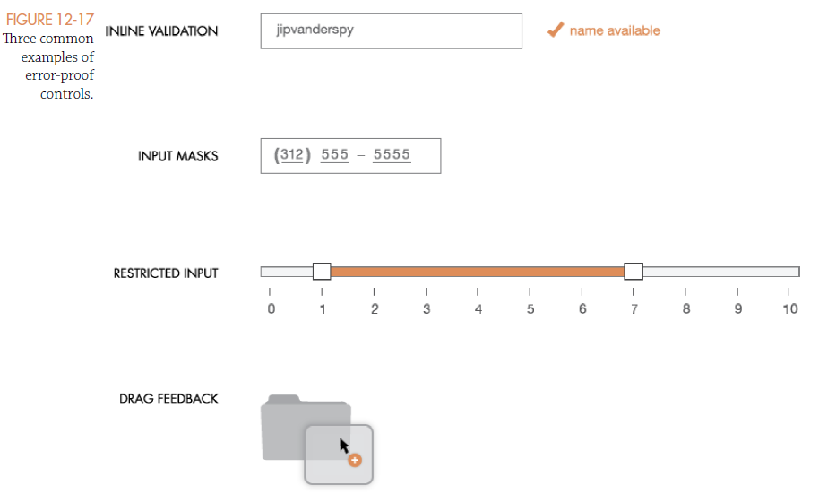

Slide 50
Get Me Out of Here
Often called an escape hatch, a get me out of here is a clear exit mechanism from any screen in your application back to a known place, such as a home page or hub.
User may end up getting lost and want to start over when using complex application/website

Slide 51
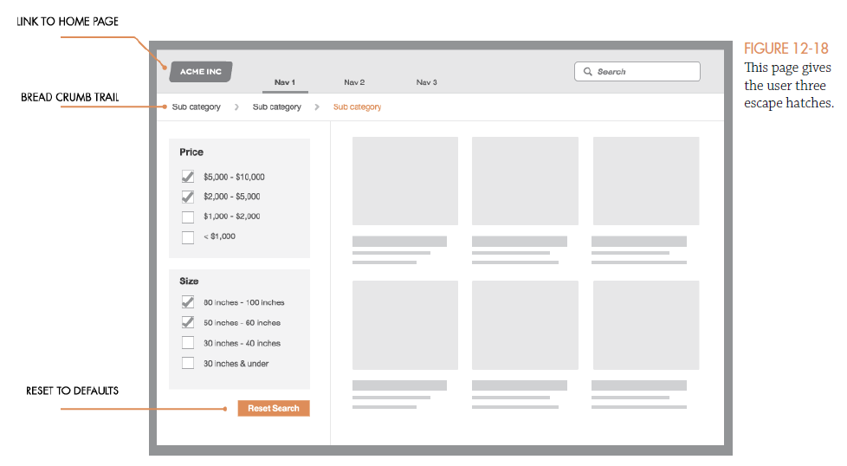
Get Me Out of Here
Often called an escape hatch, a get me out of here is a clear exit mechanism from any screen in your application back to a known place, such as a home page or hub.

Slide 52
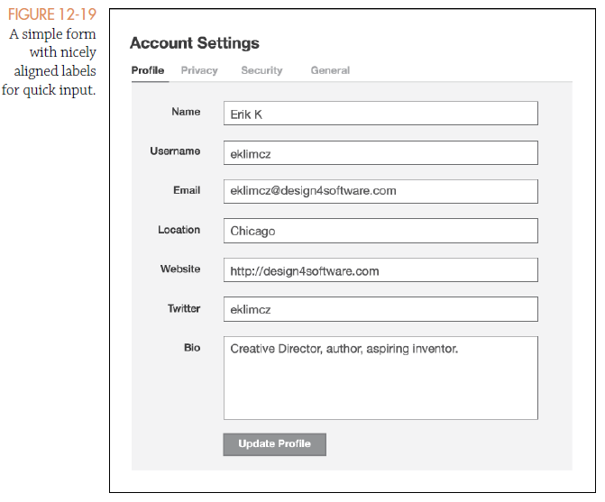
Right / Left Alignment
Use right-align input labels and left-align input controls in a form so users can make quick associations.

Slide 53
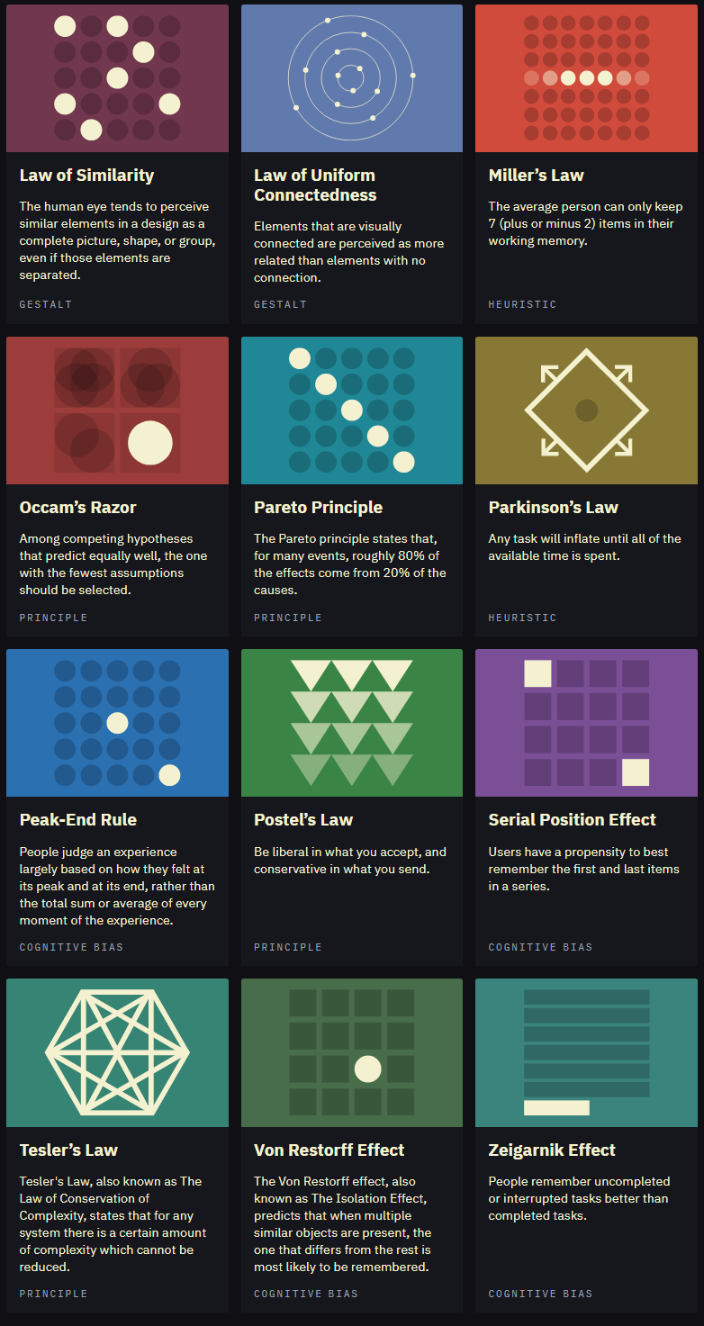
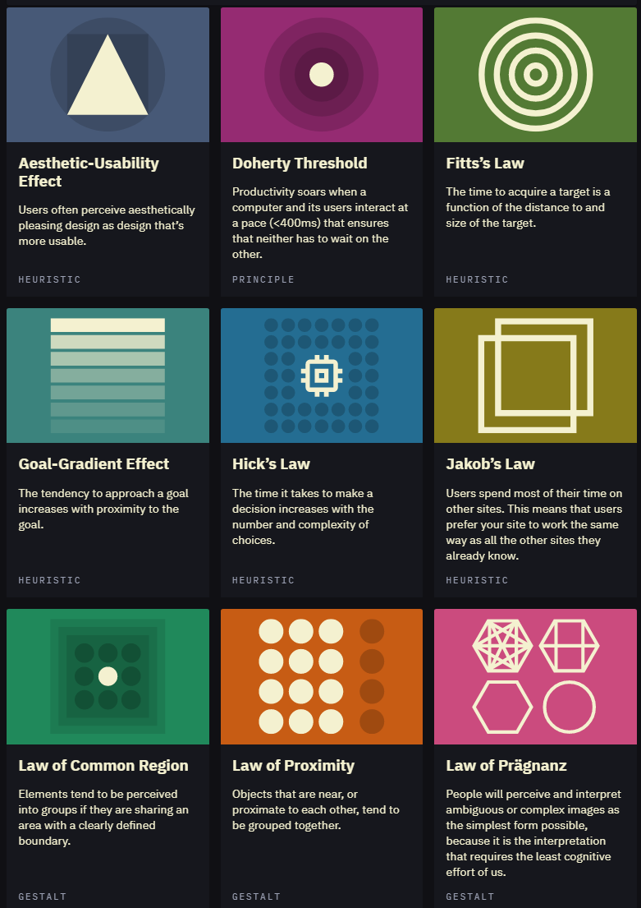
How about other criteria / heuristics?
Home | Laws of UX

Slide 54
About Testing and Giving Feedback
Evaluating the designs

Slide 55
Usability Analysis Method Expert Review Heuristic Evaluation
Method of usability evaluation, in which one or more reviewers - preferably experts - compare an interactive system with a list of heuristics (= guidelines) and determine at which points the interactive system does not follow (or follows) these heuristics Set of heuristics must be manageable, usually 10 Experts can be usability experts or experts in the field of application

Slide 56
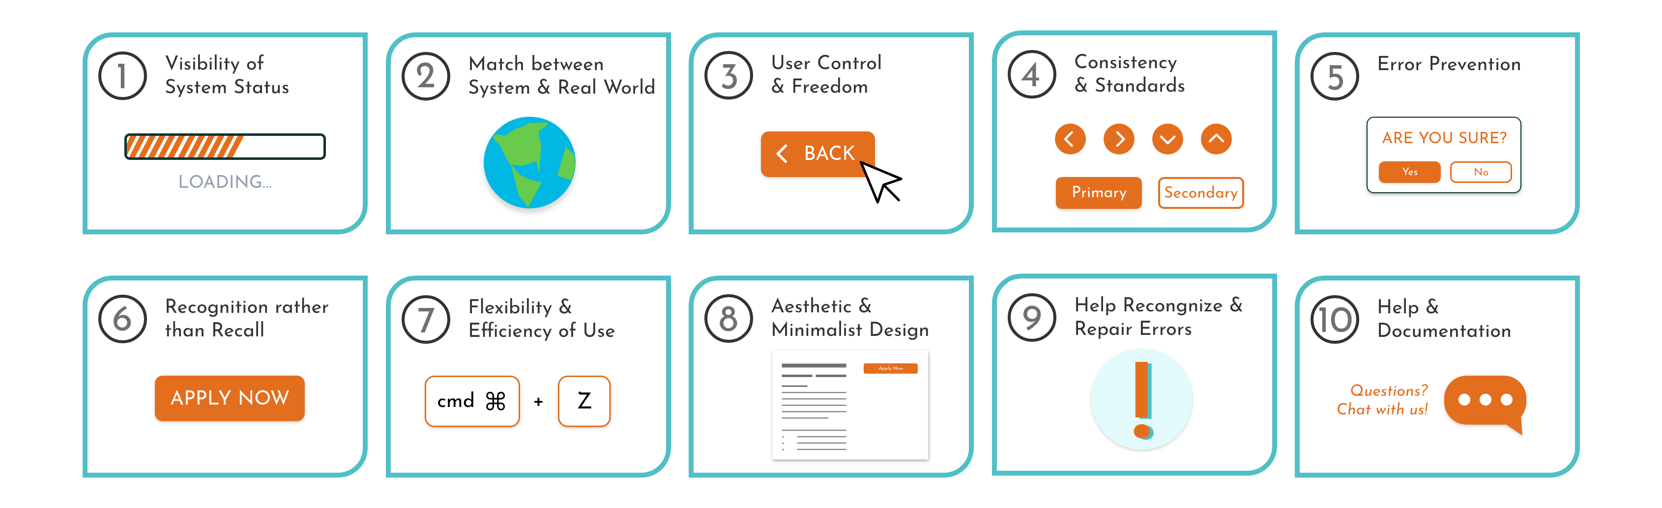
What are usability heuristic (guidelines)?
General rules of thumb that help to achieve and evaluate usability. Guidelines come from different sources (Refs: 1, 2, 3)
Nielsen’s 10 Usability Heuristics
Refs, 1, 2, 3: Norman (2016), Shneiderman (2016), Nielsen (2005)

Slide 57
Nielsen’s 10 Usability Heuristics
Offer informative feedback Pay attention to the experience and knowledge of the users Grant the user control and freedom Pay attention to consistency and consider standards Support the user in avoiding errors Minimize mental stress Enable flexible and efficient use Simple and aesthetic design Allow for easy troubleshooting Offer help and documentation

Slide 58
Heuristically thinking… dealing with BIAS
Cognitive biases… we all have them, and they have them too
Basically, it goes with the definition: “human centered”… it won’t be black and white
Why:
Information processing shortcuts
The limited processing ability of the brain
Emotional and moral motivations
Distortions in storing and retrieving memories
Social influence
…

Slide 59
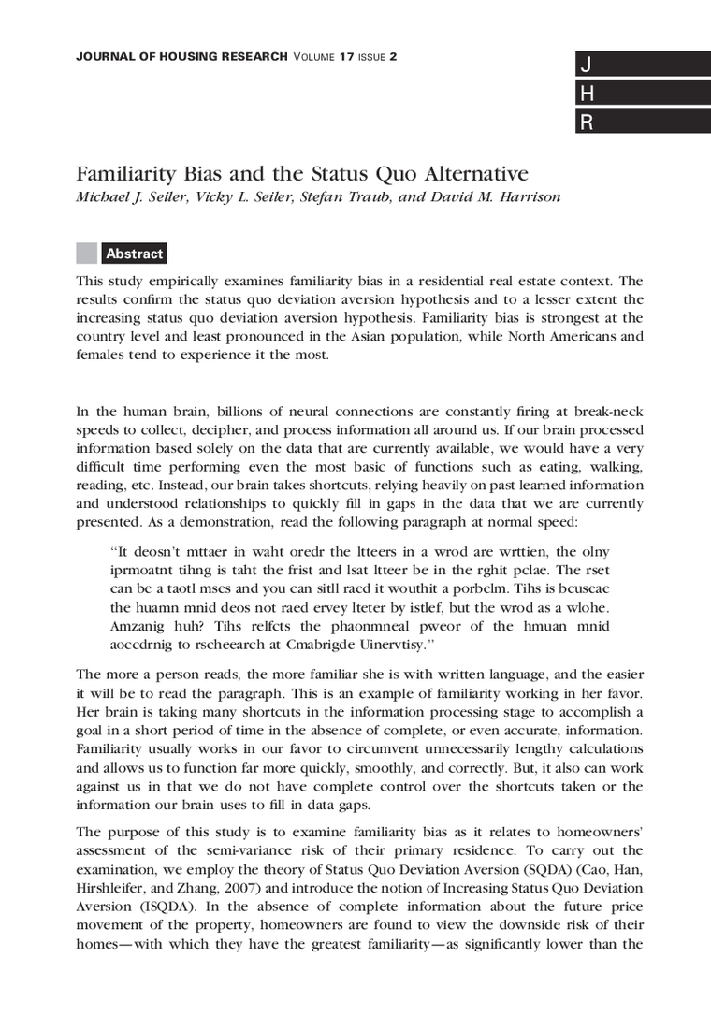
Familiarity bias
Familiarity bias

Slide 60
Self-serving bias
For example:
A student gets a good grade on a test and tells herself that she studied hard or is good at the material. She gets a bad grade on another test and says the teacher doesn’t like her or the test was unfair.
Athletes win a game and attribute their win to hard work and practice. When they lose the following week, they blame the loss on bad calls by the referees.
A job applicant believes he’s been hired because of his achievements, qualifications, and excellent interview. For a previous opening he didn’t receive an offer for, he says the interviewer didn’t like him.

Slide 61
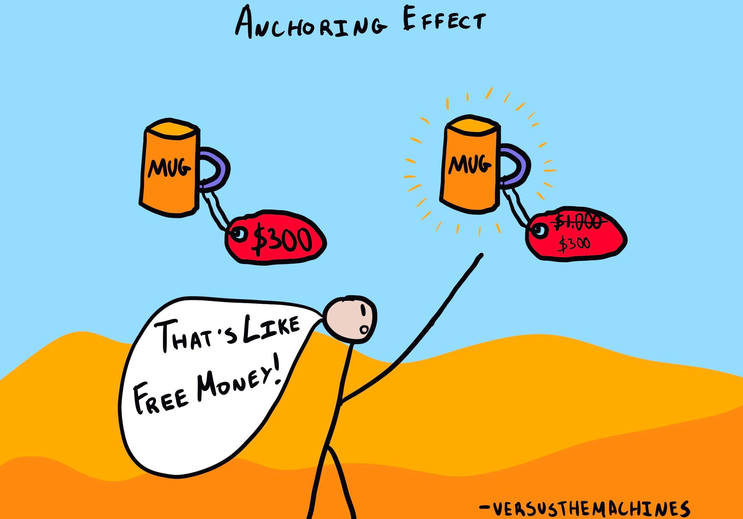
Anchoring bias

Slide 62

Survivorship Bias
How ‘survivorship bias’ can cause you to make mistakes - BBC Worklife

Slide 63
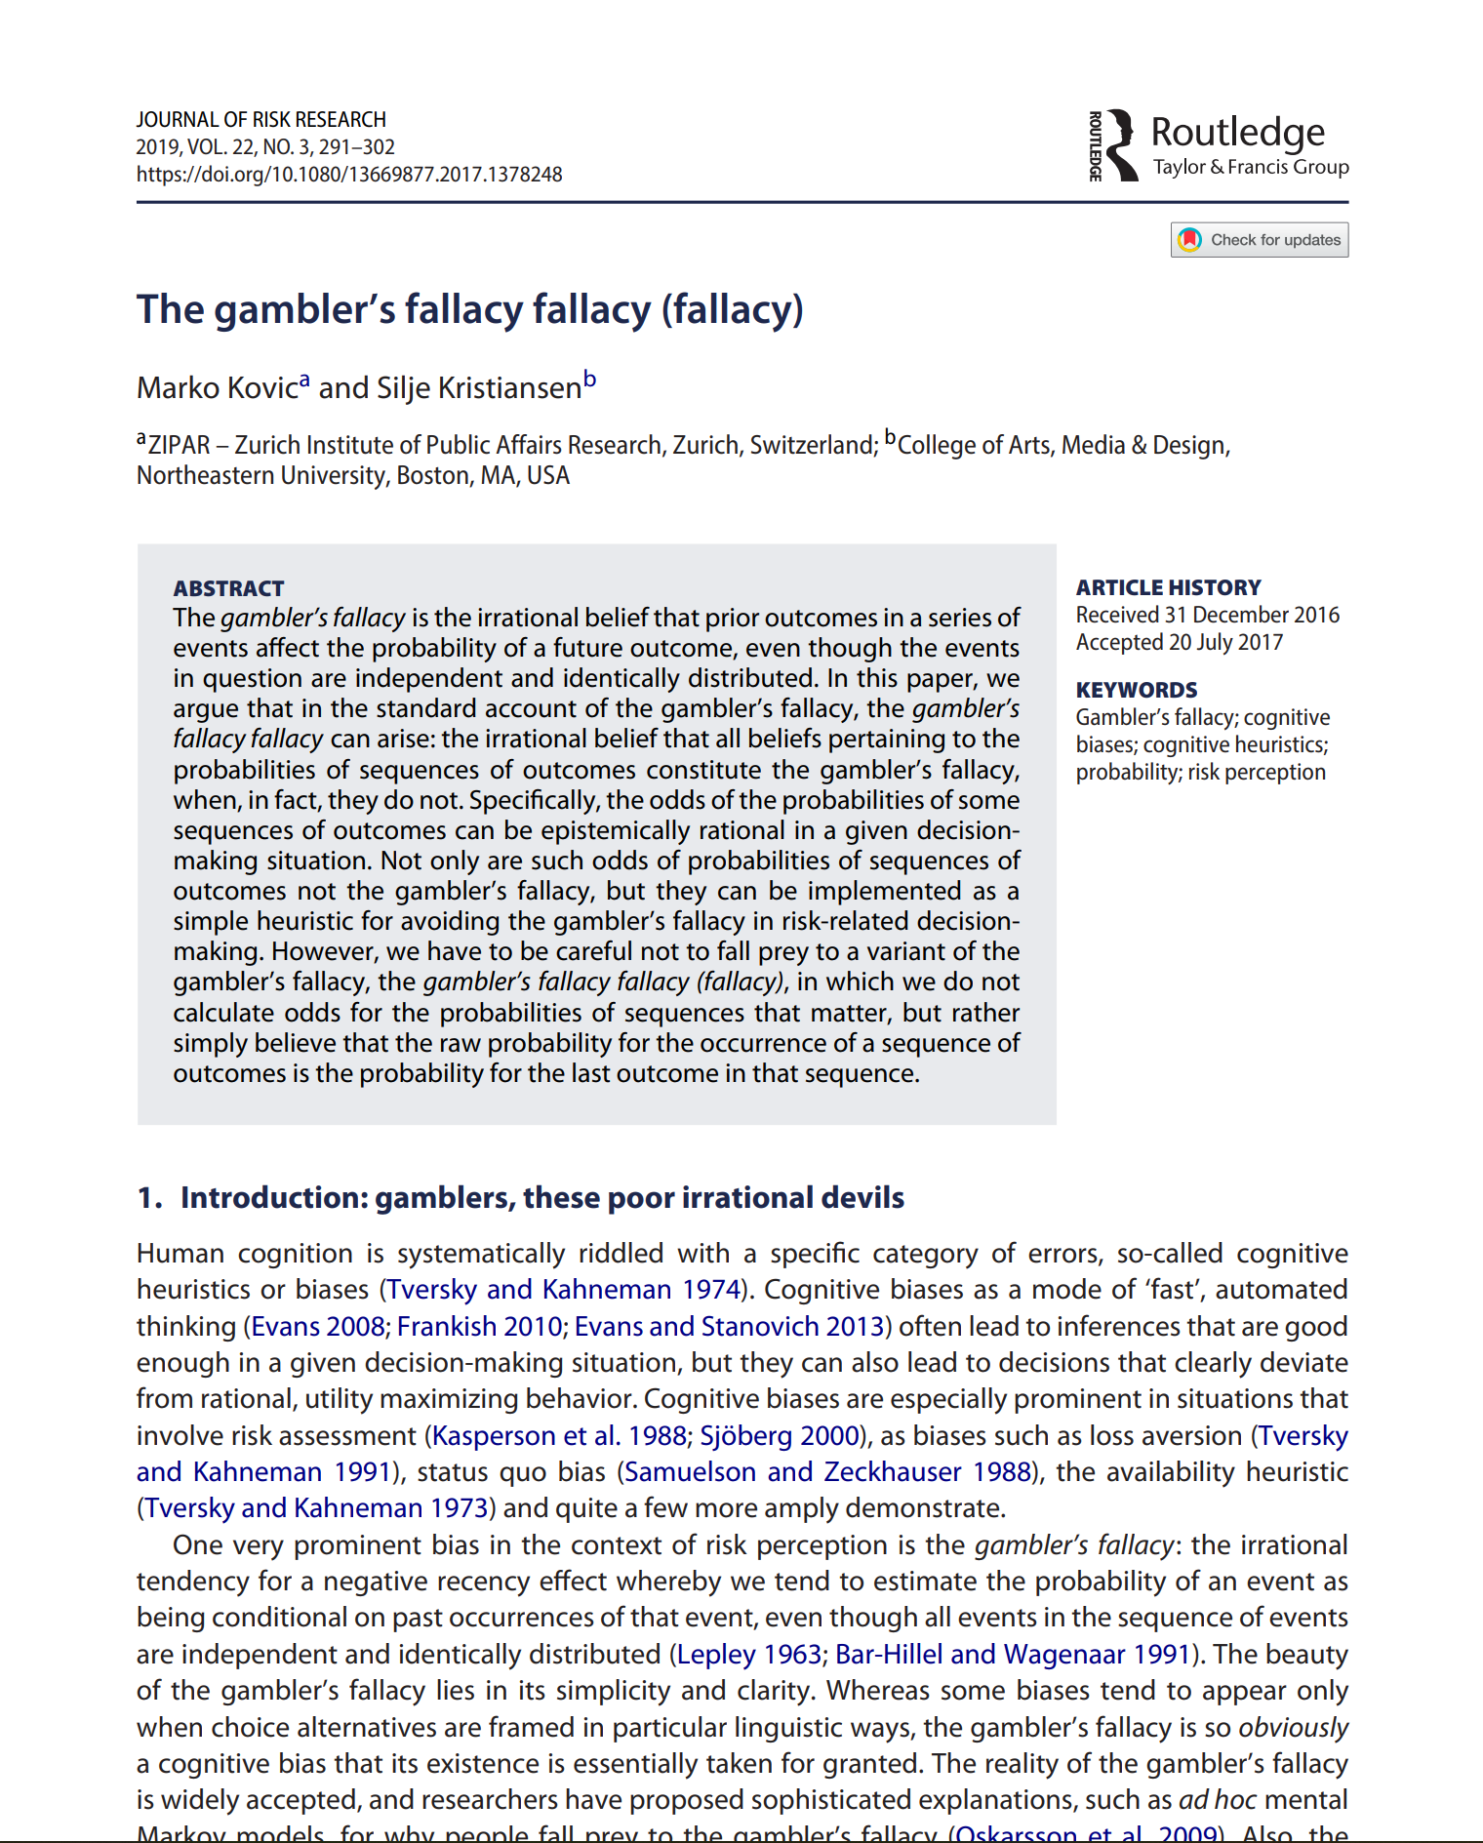
Gambler's Fallacy

Slide 64
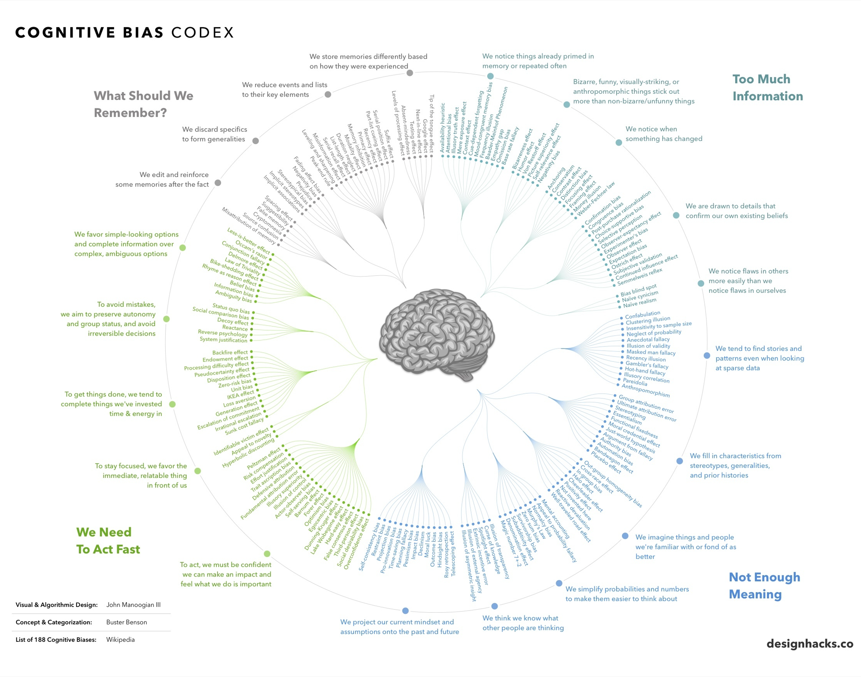
Every Single Cognitive Bias in One Infographic (visualcapitalist.com)

Slide 65
From the UI/UX heuristics view?
Framing effect – how we put it across…
“What did you like/dislike while using this X”
can cause users to only focus on the positives/negatives of the X
Confirmation bias
We like data that confirms our existing hypothesis/beliefs and discard those which challenge them…
“Have you ever done/considered doing Action X through App Y”, and the participant says, “Yes! All the time!”…
Why did they do it? How many times did they do it? Show how?
Hindsight Bias
‘“I knew that the exams will be postponed due to the pandemic”, said my friend when her exams got postponed due to the Covid-19.’
Hindsight bias interferes with the learning from new experiences due to the overconfidence one builds on their supposed ability to make predictions.
Don’t Let Your Brain Deceive You: Avoiding Bias In Your UX Feedback — Smashing Magazine

Slide 66
From the UI/UX heuristics view?
Social Desirability Bias
Hard for people to tell/say what they think is outside the norm
Sunk Cost Fallacy
Causes a lot of damage not only in research but also in major life choices (marriage/debt etc.)
It is hard to abandon something that we have invested a lot emotionally
Serial-Position Effect
Your name starts with an M and your name is part of an alphabetically ordered list… sorry to say but your name is not likely to be noticed
Due to the way our memory gets constructed, we pay more attention to the earlier and later parts of long lists.
…
Don’t Let Your Brain Deceive You: Avoiding Bias In Your UX Feedback — Smashing Magazine

Slide 67
From the UI/UX heuristics view?
Implicit Bias
Our attitudes and stereotypes we associate to people without our conscious knowledge
Embedded into into our consciousness from a very young age through media, people around us and popular culture, even by nature…
Our duty is to really understand what is going on inside their mind and how they think, even…
Fundamental Attribution Error
Tendency to overemphasize personal characteristics and ignore situational factors in judging others’ behavior
When user says “oh, hahaha, I made a mistake”, it’s really time to pay attention.
Don’t Let Your Brain Deceive You: Avoiding Bias In Your UX Feedback — Smashing Magazine

Slide 68
Testing your protypes

Slide 69
Test execution
Greeting
Introduction to Thinking Aloud Explanation of the process (including declaration of consent)
Questions
Opportunity to query demographic data / computer expertise / previous experience, specific questions – (relationship to the target group!) Encourage test takers to talk; show that you are listening
Tour
Does the participant recognize what he has in front of him? Which page / application, what is the purpose of the application?
Tasks
Reading the tasks aloud Observe, moderate (no solution hints!)
Summary
Questions from the moderator Questions from the development team Say goodbye, thank you, hand over the expense allowance

Slide 70
Test setup

Slide 71
3 Debrief
Goal:
List of the most serious problems that have surfaced during the tests List of issues to fix by the next round of testing
Focus on the most important problems! 1. Frequency of occurrence
2. Effects of the problem when it occurs

Slide 72
Feedback to another team

Slide 73

Team heuristics evaluation exchanges
+
Screen layout
Refs, 1, 2, 3: Norman (2016), Shneiderman (2016), Nielsen (2005)

Slide 74
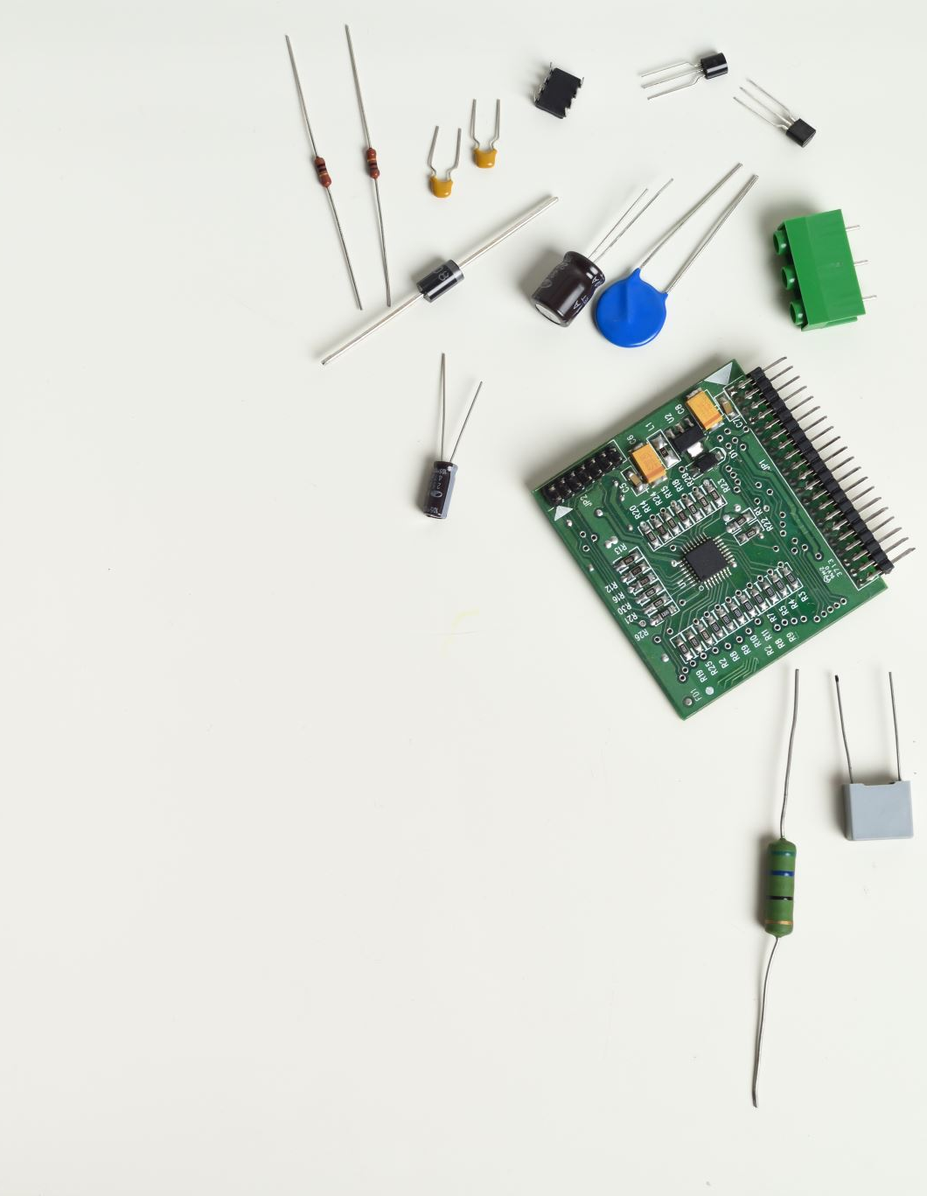
Design Evaluation: Fit for Purpose

Slide 75
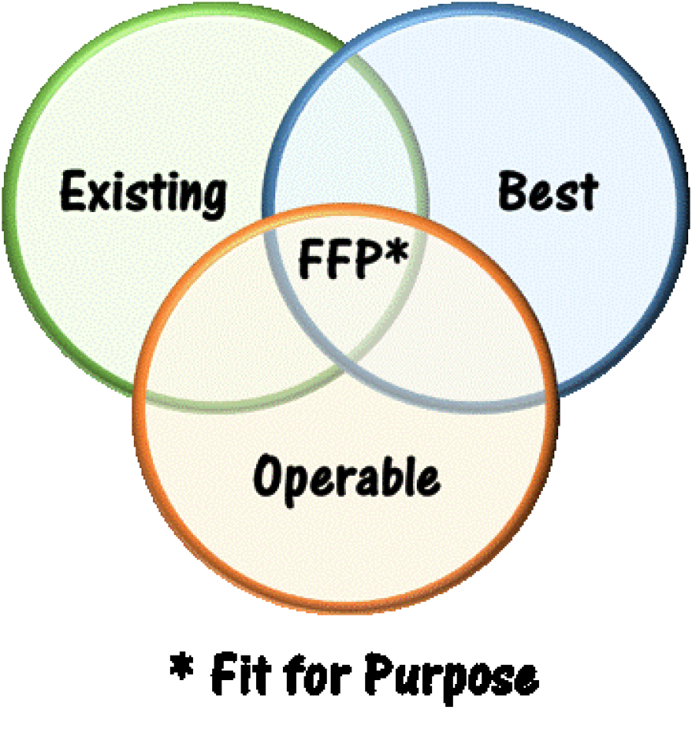
Fit for Purpose

Slide 76
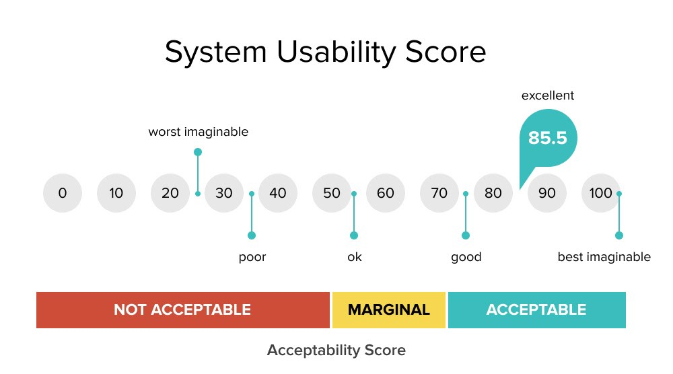
Design Useability

Slide 77
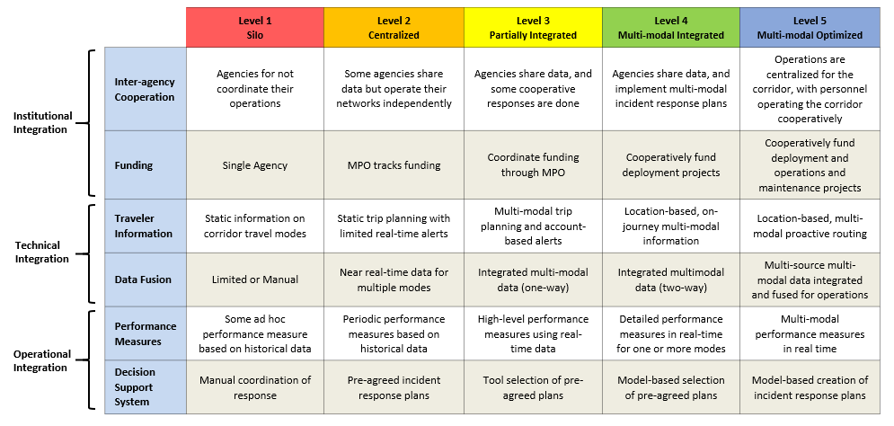
Design Capability Measures

Slide 78
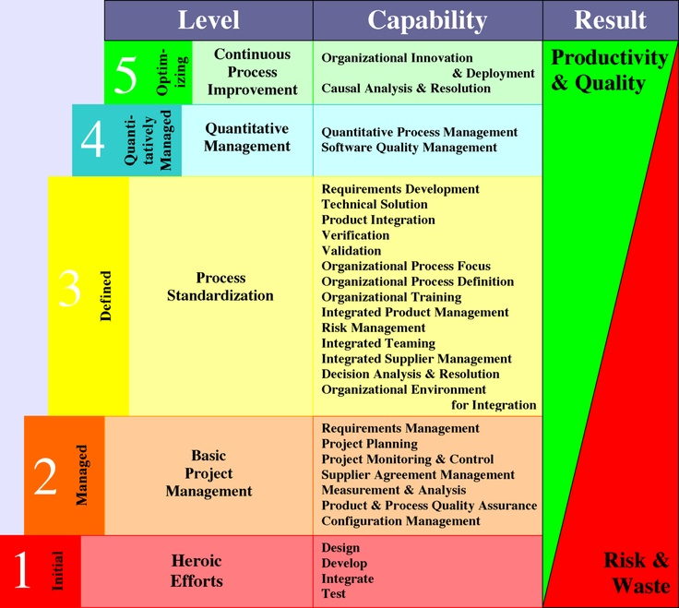
Value Delivery

Slide 79
Before Next Lecture
Watch this video:
Google I/O 2014 - The design sprint: from Google Ventures to Google
https://youtu.be/aWQUSiOZ0x8
What are the similarities and differences of Google Ventures SPRINT to the Design thinking process from D. School ?

Slide 80
Further reading
Handbook of Usability Testing, Jeffrey Rubin, Dana Chisnell
Very concrete and practical guide to the implementation Usability Tests (Templates, Checklisten, etc.)
Rocket Surgery made easy, Steve Krug
Concrete guidelines for "do it yourself testing" Recommendations for tools, templates, checklists
Don‘t make me think, Steve Krug
Easy-to-understand, practical introduction to usability
Measuring the User Experience, Tom Tullis, Bill Albert
Measuring and quantifying usability Detailed guide to user testing
Nielsen, J. (1994). Guerrilla HCI: Using Discount Usability Engineering to Penetrate the Intimidation Barrier. Online: http://www.useit.com/papers/guerrilla_hci.html

Slide 81
Practical session
Team to agree on sketch (around 10 screens)
Run Wizard of Oz testing of the sketch with another team
LinkedIn Learning: Figma tutorial, one of:
Figma Essential Training: The Basics, or
Figma for UX Design
Assign 2 screens for each team member to implement on Figma
Team to collaborate to make a ‘smart’ Figma prototype

